Slide 1
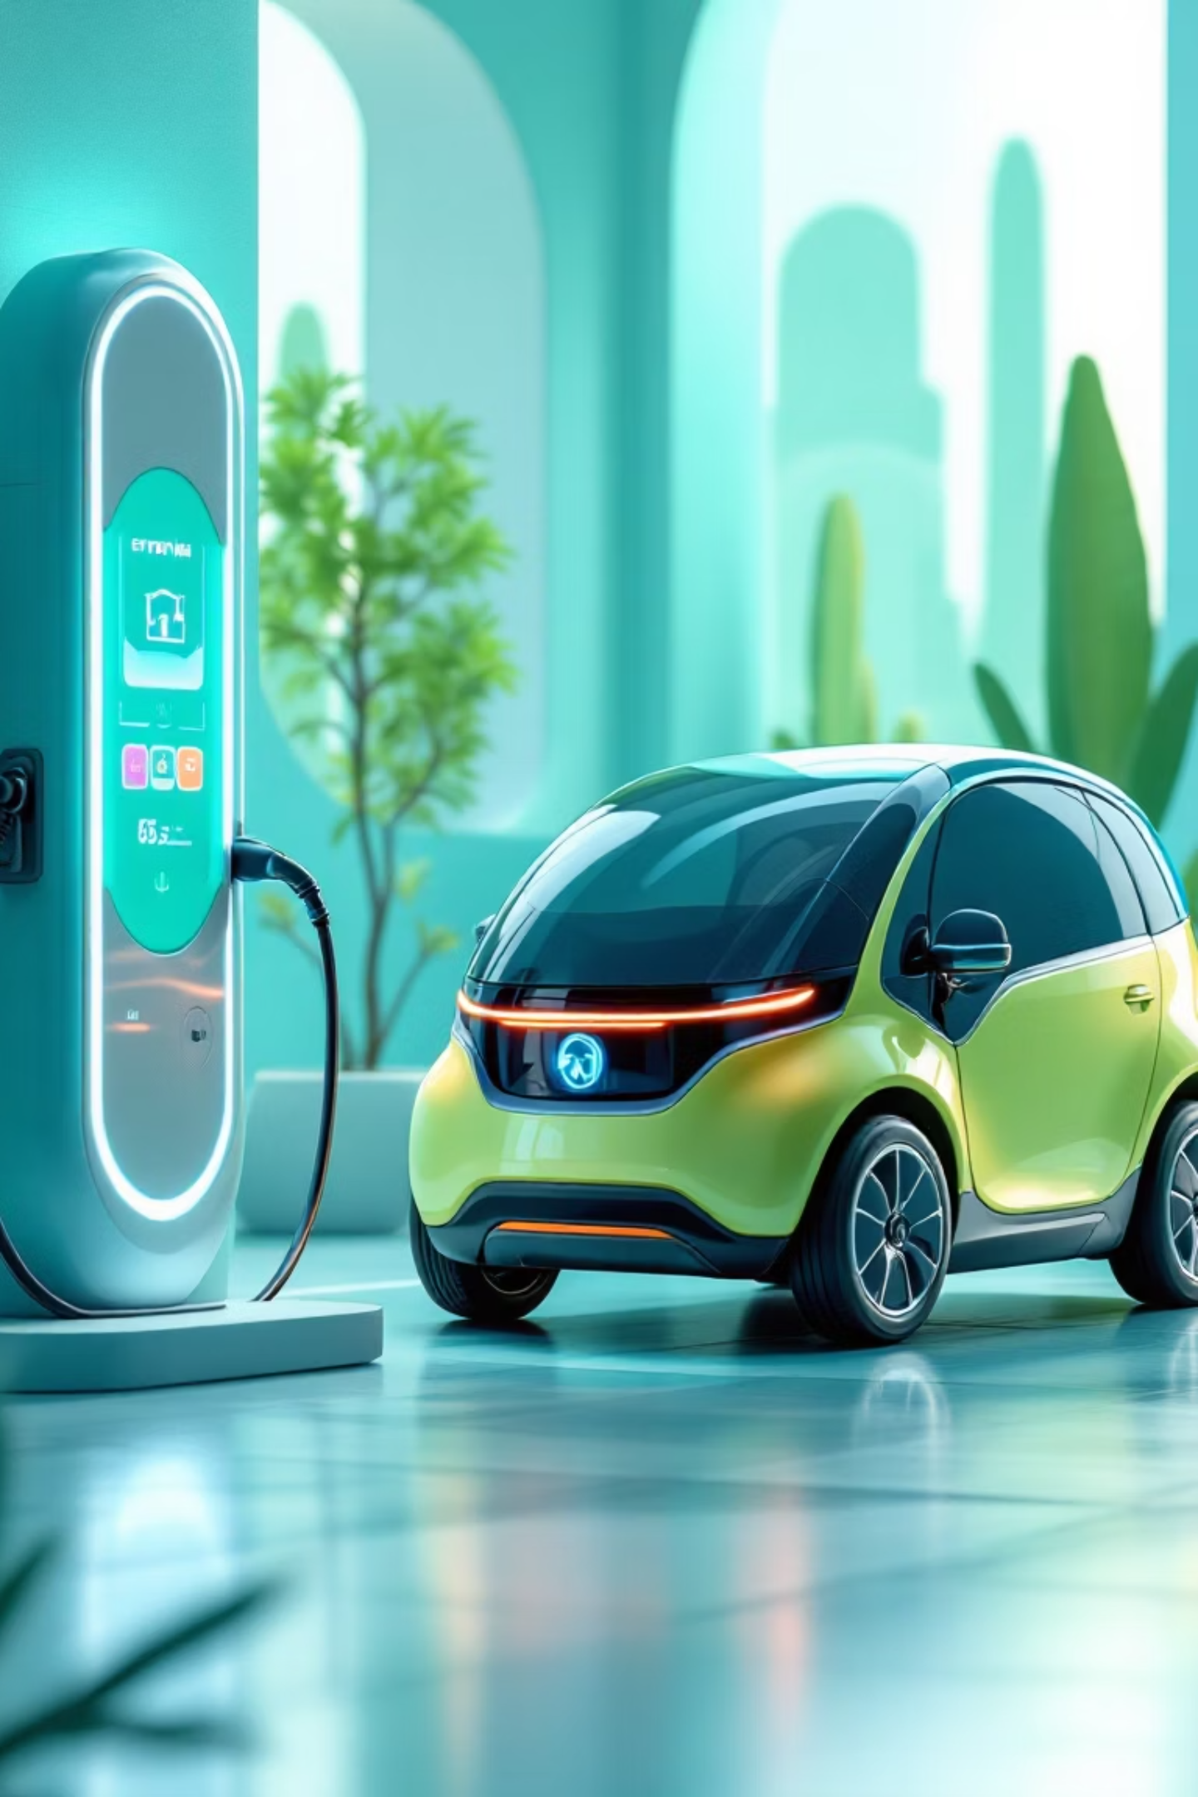
Smart Low-Battery EV Routing + Auto-Reserve System
Zero Range Anxiety. Fully Automated Charging.
PHOTONEDGE Team - Shreyash Atre (Leader)
- Samira Vadake
- Vaibhav Bandgar
Hack The Flame 2025
EV • Routing • Automation • IoT • AI

Slide 2
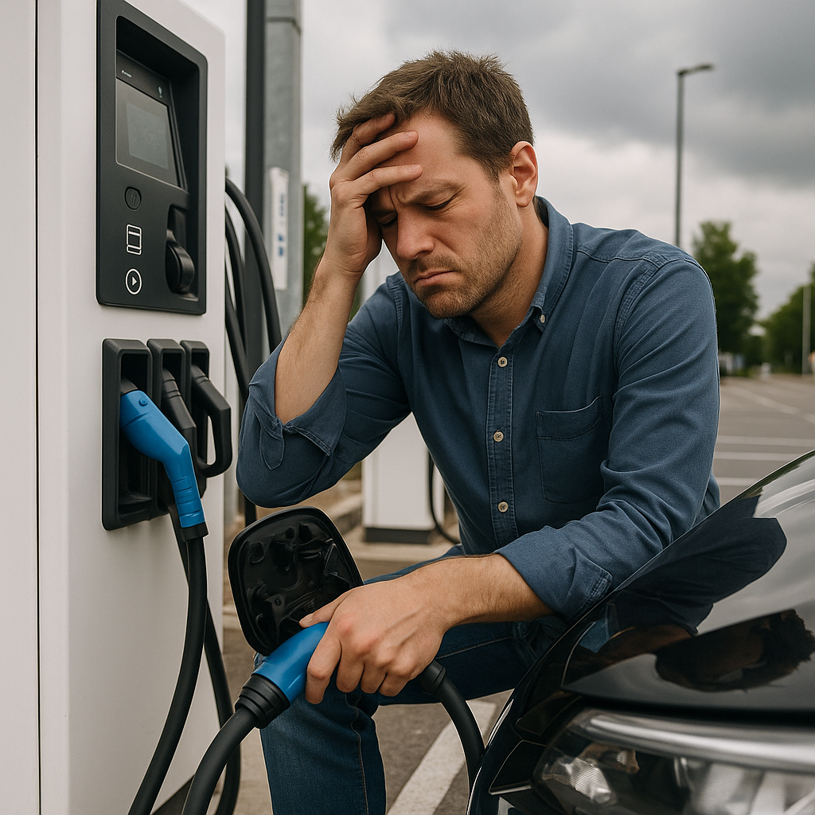
The Problem
EV drivers face persistent challenges that create stress and inefficiency in their daily charging routines:
Charging availability is unpredictable — queues, offline chargers, and last-minute slot conflicts are common
Users manually search for stations only when battery levels drop critically low
No unified system combines battery percentage, distance calculations, real-time traffic, and station occupancy data
Society-based chargers require manual verification calls and coordination, causing frustrating delays
This leads to unnecessary detours, wasted time, range anxiety, and operational inefficiency
Result: Persistent range anxiety paired with inefficient charging experiences

Slide 3



Our Solution
Continuous Monitoring
Smart Suggestions
Auto-Reserve
Real-time battery tracking ensures you're always informed about your vehicle's power status
Automatic charger recommendations activate when battery drops below 20%
System automatically reserves optimal charging slot when battery reaches critical 10% threshold
Intelligent Routing
QR Gate Access
Turn-by-turn navigation with dynamic rerouting based on real-time conditions
Streamlined entry verification for gated society chargers in MVP version
Outcome: Fully automated, stress-free charging experience from detection to completion

Slide 4







Key Features
Low-Battery Detection
Nearest Charger Discovery
Proactive monitoring triggers intelligent responses before battery reaches critical levels
Instant suggestions for both public stations and society-based charging infrastructure
Auto-Reserve System
Dynamic Rerouting
Automatic slot booking at critical battery thresholds eliminates manual coordination
Real-time path optimization adapts to traffic, charger availability, and changing conditions
QR Verification
Predictive Logic
Fast, contactless gate entry for residential and society charging locations
Smart routing algorithms optimize for time, distance, and charging availability
Live Charger Availability: Real-time status updates using mock data infrastructure for MVP demonstration

Slide 5






System Architecture
Electric Vehicle
Continuous battery monitoring and data transmission to mobile application
Mobile App Interface
User-facing Flutter/React application communicating with backend services
Backend API Layer
Node.js server processing requests and managing system logic
Data Management
Simulated Charger Network (JSON) • Reservation engine • WebSocket real-time updates
Navigation Integration
Google Maps/Mapbox providing turn-by-turn routing to selected charging stations
Access Verification
QR code scanning system for society gate entry (hardware-free MVP approach)
Note: Real ANPR hardware integration planned for future deployment phases

Slide 6

Technology Stack
Frontend Layer
Real-Time Communication
Flutter / React
WebSockets
Cross-platform mobile application with responsive, intuitive interface design
Live updates for charger availability, reservation status, and system notifications
Backend Services
Charger Data
Node.js (Express)
Simulated Charger Network (JSON)
RESTful API endpoints handling routing logic, reservations, and data management
Simulated charger network demonstrating system capabilities without physical infrastructure
Data Persistence
SQLite
Access Control
Lightweight database solution optimized for MVP demonstration and testing
QR Code Scanning
Software-based verification eliminating hardware dependencies for MVP phase
Routing Engine
Google Maps / Mapbox
Architecture Note: Current implementation uses mock data and simplified logic. Future phases will integrate ML models for wait-time prediction and intelligent charger availability forecasting.
Professional-grade navigation with real-time traffic integration

Slide 7
Business Model Overview
Why Our Prototype Stands Out
key Partners: EV manufacturers, societies, charging networks, IoT device providers. key Activities: Routing engine, real-time monitoring, ML prediction models, charger integrations
Customer Segments: EV owners, charging stations, society EVs, logistics/fleet operators
Channels: Mobile app, web dashboard, EV OEM partnerships
key Resources: Cloud infrastructure, APIs, ML models, IoT gateways
Cost Structure: Server hosting, maps API, ML training, hardware integration
Revenue Streams: Subscriptions, station commissions, API licensing, enterprise fleet plans
Clean UI Excellence
Smart Automation
Polished interface demonstrating complete end -to-end EV charging workflow with professional design standards
Intelligent auto-reserve and dynamic reroute logic eliminates manual intervention and decision fatigue
Realtime Updates
Live charger status simulation provides authentic user experience without physical hardware dependencies
Immediate Benefits
Scalable Architecture
Fast QR-based society access system requiring zero hardware installation
Designed for society charging networks
Functions completely without physical EV or charging station infrastructure
Public charging station integration
Fleet management expansion
Production-ready demonstration of core automation features
Commercial logistics EV operations

Slide 8
Prototype Demo + Roadmap
What Our Demo Shows
01
02
03
Battery Alert Trigger
Charger Discovery
Reservation Processing
Simulated low battery notification activating system response (mocked sensor data)
Interactive map displaying nearby charging stations with availability status and details
Backend reservation system confirmation with real-time WebSocket communication
04
05
QR Access Screen
Dynamic Rerouting
Society gate verification interface demonstrating contactless entry workflow
Intelligent path recalculation popup responding to changing conditions and availability
Phase 1: Foundation
Phase 3: Access Control
Complete UI/UX implementation with dummy charger network simulation and core navigation
QR gate demonstration system (MVP replacement for future ANPR hardware integration)
1
2
3
4
Phase 2: Intelligence
Phase 4: Production Scale
Auto-reserve logic deployment with sophisticated reroute algorithms and optimization
Real charger network APIs, ML-powered wait-time predictions, and availability forecasting models

